Slide 1
F-WASP Update: Fixed-Wing Autonomous Synthetic Pilot
Soar Workshop, 2021-06-15
Randolph M. Jones
rjones@soartech.com

Slide 2
TacAir-Soar
Incremental reimplementation of TacAir-Soar
Soar model that generated behavior to varying levels of fidelity for every US fixed-wing air mission
Designed to serve as a “drop-in replacement” for human role players in training simulations
Areas of particular strength: air-to-air intercepts, close air support, strike packages, coordination in mixed human/system teams, communication
Full-spectrum behaviors for blue fixed-wing air missions
Decision making based on situational understanding and least-commitment reasoning
Symbol-level reasoning that supports mixed-team collaboration, communication, directable autonomy, trustable autonomy

Slide 3
Why a Reimplementation?
Update the implementation to keep pace with the current version of Soar
TacAir-Soar worked in Soar 6 and 7, but Soar 8 would have required significant changes
Use the many lessons we have learned about agent development and knowledge representation from TacAir-Soar and two more decades of experience to create a cleaner and better organized system that will be easier to extend in the future
Move to a more data-driven behavior design, so that many behaviors can be configured without having to touch the Soar code
Easier extensibility and configuration of behaviors
Behavior parameterization to improve human-system interaction
Use Soar 9's declarative semantic memory for knowledge management (this part is not yet implemented)
Enforce a cleaner separation between "decision-making processes" (implemented as Soar productions/procedural knowledge) and declarative knowledge
Use the RIDL (Reusable Intelligence Declarative Language) package for XML-based implementation of behavior parameters and the agent's goals structure
Switch from the "single goal stack" ("Michigan approach") Soar code organization used by TacAir-Soar to the "forest of goals" approach favored at SoarTech
Improves the ability to structure multi-tasking and interacting goals
Keep the code "safe" from an export-control perspective
To the extent possible, base behaviors and tactics on publicly available materials
If necessary, implement any behaviors that might be export-controlled by separable libraries that are triggered by configuration parameters
Beyond TacAir-Soar
Update tactical knowledge, sensors, weapons systems to the 21st century
Shift in focus from “human role-player replacement” to “drone intelligent controller”

Slide 4
Development Approach
Manual knowledge acquisition, knowledge engineering, knowledge authoring
Focus on combining strengths of cognitive systems and software engineering
Modularity
Knowledge reuse
Data-driven configurability
Behaviors that emerge from modular “first principles”
Use the RIDL package for a declarative representation of the goal hierarchy
Goals, parameters, subgoal relationships, activation/achievement conditions all represented in an XML file
Reusable interpreter written in Soar
“Forest of goals” representation approach
Allows interleaving of reasoning about multiple goals simultaneously
Some Randy-idiosyncratic Soar design and implementation patterns
E.g., liberal use of the :o-support flag

Slide 5
Current Status
Behaviors migrated from TacAir-Soar
Basics of situational understanding and management of sensed contacts
Route and waypoint navigation
Formation flying
4-ship and 2-ship command hierarchies
Semi-natural-language inter-agent communication
Air-to-air intercepts
Commit criteria, drop-criteria, targeting and sorting, weapons employment
Very simple air-to-ground attacks and recon
Beyond TacAir-Soar
Taxi/Takeoff behavior
Drone-centric, semi-independent command groups
External services for planning- and scheduling-oriented tasks
Message-based API for much easier integration with external systems (simulators and actual aircraft hardware)
Rudimentary graphical goal display that reuses the RIDL goal representation
Liberal use of XML and JSON files for mission and behavior configuration parameters

Slide 6
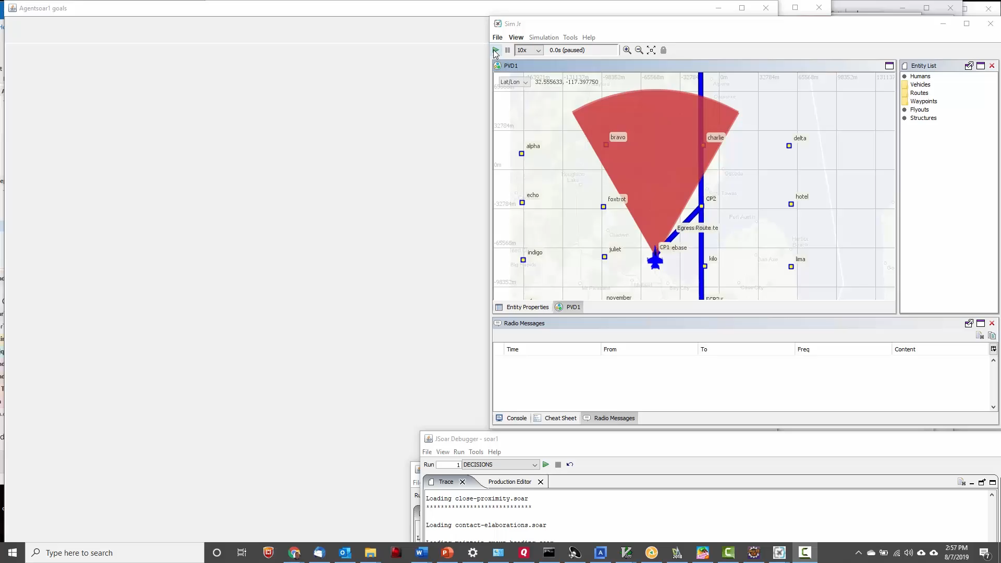
F-WASP BARCAP Demo with Goal Display

Slide 7
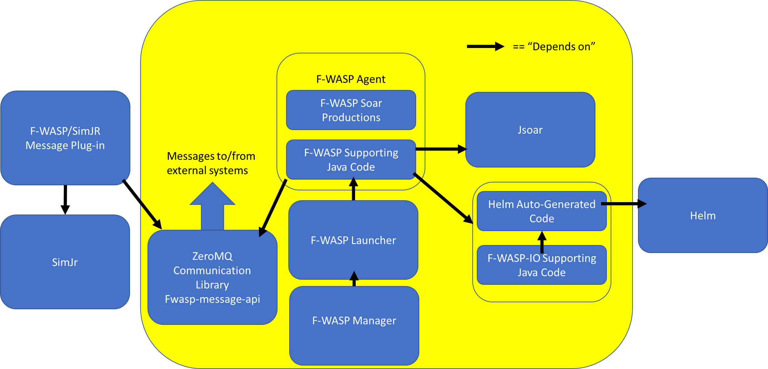
Current System Architecture

Slide 8
Summary
Nuggets of gold
TacAir-Soar’s legacy lives on
F-WASP is satisfying a number of goals beyond TacAir-Soar’s
F-WASP development is being actively funded
F-WASP is going places TacAir-Soar never dreamed, in terms of architecture are application
F-WASP has caused and/or uses the development of several related tools that are reusable for other Soar agents
Lumps of coal
F-WASP does not yet come close to replicating all of TacAir-Soar
F-WASP development is unfortunately incremental by necessity
We have a lot more ideas than we have time to implement them
There are still many problems for which we have not yet identified the best solutions

